Slide 1
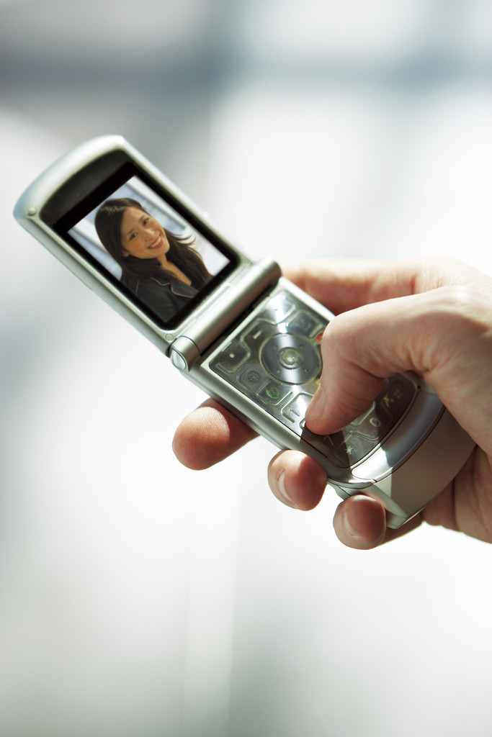
So You Want to Buy a Cell Phone !

Slide 2
What You Need To Decide
What features do I want?
How many minutes a month will I use it?
What areas will I use it in?
What rate plan should I choose?
How much can I afford?

Slide 3
Cell Phone Features
MP3
Colour Display
Camera
Web Browser
Games
Speaker Phone
Voice Call
Call Display
10-4
Bluetooth
PDA
GPS
Text Messaging
Programmable Ringtones
Clock
Calculator
PC Synchronization
Other

Slide 4

Any free phone offered when you sign a basic contract usually has the following features:
Web browser
Camera
Bluetooth
Speakerphone
Downloadable capable for ringtones
Voicecall
(Other features usually come only with more expensive phones that you have to purchase with the plan.)

Slide 5

How will I Use The Phone?
Talk to family and friends?
Text Message?
Download Music?
Play Games?
Browse the web?
Yes
Probably
Perhaps
Maybe
Possibly

Slide 6
In What Areas Will I Use My Phone?
In The Country
In The City
When I travel
BE CERTAIN TO CHECK THE SERVICE AREA MAP!

Slide 7

Providers and Plans
There are many providers that offer various plans designed to address the needs of various kinds of users.
For example in large, urban centres in Canada there are more than 9 carriers offering more than 191 different plans.
Which one is for you?

Slide 8
Providers and Plans
Things you need to know about the plan include such things as:
1. What is included in the monthly charge?
2. What is the monthly charge including taxes?
3. What is the charge if I go over my allocated minutes?
4. What are the long distance charges?
5. What are the charges for text messaging and web browsing?
6. etc. - such a downloading ringtones

Slide 9
Group Assignment
You will be given 1 service provider and 2 sets of data that will indicate different types of usage and needs based on 1 month’s normal use.
You are to calculate what the monthly and yearly costs will be and report back to the class with a recommendation as to whether or not this would be a good plan to consider.
Pay As You Go Plans require that you purchase a phone.

Slide 10
The Data
Scenario A
Total minutes talk – 145
110 with family and 4 friends
65 in evening and on weekend
1 long distance (Can)– 4 minutes
Total text messages (SMS)– 8
Total video messages (MMS) – 3
Total Emails – 4
Web Browsing – 15 KB
Scenario B
Total minutes talk – 285
220 with family and 4 friends
65 in evening and on weekend
0 long distance (Can)– 0 minutes
Total text messages (SMS)– 18
Total video messages (MMS) – 5
Total Emails – 12
Web browsing – 35 KB

Slide 11

Some Final Advice
Know your likely needs before getting a plan.
Be careful about what contract you sign. It could be costly to get out of it.
See if your parents have a corporate plan that allows you to join.
Consider a family plan if more than one member of the family is getting a phone.
Once you have established your pattern of usage over a few months you can talk to the provider to discuss ways of reducing costs.

